Slide 1
Combined Assurance and the 3 Lines of Defence,
Deon van der Westhuizen

Slide 2
Richard Chambers
Boardroom presence
Governance processes
Risk Management processes
IT Auditing
CAAT’s

Slide 3
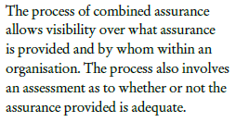
Process of combined assurance

Slide 4
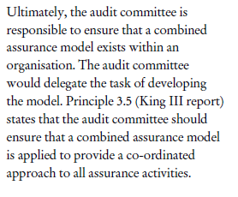
Ultimate accountability

Slide 5
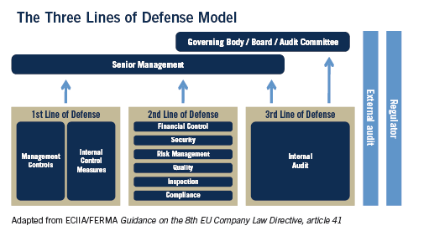

Slide 6
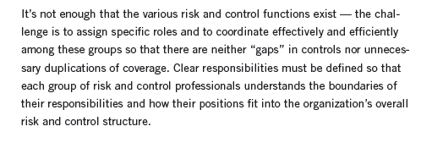
Effective and efficient coordination

Slide 7
Governing bodies/senior management?
Not part of three lines model
No discussion about risk management complete without them
Primary stakeholders served by the lines
Best positioned to ensure effective implementation

Slide 8
Governing bodies/senior management?
Responsibility and accountability for setting objectives
Defining strategies to achieve the objectives
Establishing governance structures
Establish processes to manage risks

Slide 9
Differentiation
Functions that own and manage the risks
Functions that oversee risk management
Functions that provide independent assurance

Slide 10
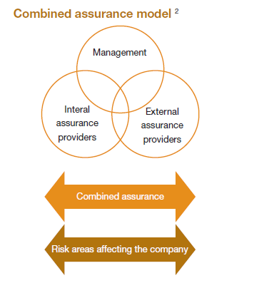

Slide 11
Functions that own and manage the risks
Operational management
  Maintaining effective controls
  Execute risk and control on daily basis
  Identify, assess, control and mitigate risks
  Policy and procedure consistent with achievement of objectives
  Adequate supervisory controls to highlight control breakdowns, inadequate processes, unexpected events

Slide 12
Functions that oversee risk management
Risk management function
  Facilitate and monitors effective implementation of RM
  Target risk exposure
  Adequate risk related information
Compliance function
  Health and safety
  SCM
  Environment
  Quality
Controllership functions
  Financial risks
  Financial reporting issues

Slide 13
Second line of defense
Established by management to ensure:-
  First line of defense is properly designed, implemented and operating as intended
  Some degree of independence from first line of defense
  In nature management functions – may intervene directly in modifying and developing control and risk systems
  Serves a vital purpose but lack true independence

Slide 14
Responsibilities
Support management policies, define roles and responsibilities, set goals for implementation
Provide risk management frameworks
Identify known and emerging issues
Identify shift in risk appetite
Assist management I to develop processes and controls to management risks

Slide 15
Responsibilities
Provide guidance and training on RM processes
Facilitate/monitor implementation of effective risk management
Alert management on emerging issues and changes in regulatory and risk scenarios
Monitor the adequacy and effectiveness of internal control, completeness of reporting, compliance with laws and timely remediation of deficiencies

Slide 16
Functions that provide independent assurance
Highest level of independence and objectivity
Independence not available in second line of defense
Assurance of effective
  Governance
  Risk
  Control
Including how first two lines of defense achieve risk and control objectives

Slide 17
Scope of third line of defense
Assurance on SCRE
All elements of risk management and control framework
  Internal environment, risk identification, assessment and response
  Information and communication
  Monitoring
Overall entity, sales production etc, and supporting functions

Slide 18
King 3 principle
Establishing an internal audit function should be a governance requirement for all organizations
International SPIA
Report to sufficient high level to be able to perform its duties independently
Have active and effective reporting line to governing body

Slide 19
Five step approach
Establish the current business profile
Assurance reality check
Risk mapping
Combined assurance design
Making combined assurance a continued reality

Slide 20
Step 1:- Current business profile
High level of understanding of what assurance is currently provided
Profile can follow a process view of activities and mapping the assurance to the process types

Slide 21
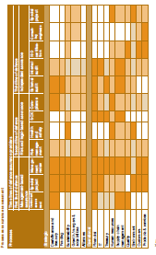

Slide 22
Building blocks
Strategic processes
  Cash, Finance, Treasury
  Funding
  Sustainability
  Growth, Mergers, Acquisitions
  Alliances

Slide 23
Building blocks
Operational processes
  Finance
  Treasury
  IT
  Human Resources
  SCM

Slide 24
Building blocks
First line of defense
Management based assurance
  Control self assessment
  Special projects
  Management review

Slide 25
Building blocks
Second line of defense
Risk and legal based assurance
  Risk Management
  Health and Safety
  SOX
  Compliance

Slide 26
Building blocks
Third line of defense
Independent assurance
  External Audit
  Internal Audit
  ISO certification
  Consulting engineers
  Special projects

Slide 27
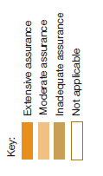
Building blocks

Slide 28
Step 2:- Assurance reality check
Assess actual assurance provided
To whom the actual assurance is provided
Quality also assessed through
  interaction with recipients
  Assessment of reports issued
Who are providing the assurance
Is the assurance coverage and quality worth the cost?

Slide 29
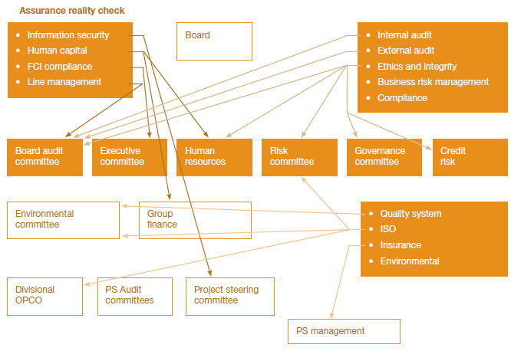

Slide 30
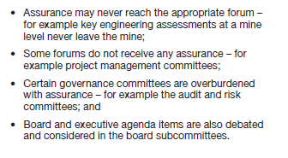
Limitations

Slide 31
Assurance providers
Internal audit
External audit
Ethics and integrity
Business ERMS
Compliance
Information security
Human Capital
SOX compliance
ISO 14001
ISO 9001
NOSA
Quality systems
Special projects

Slide 32
Step 3:- Risk Mapping
Universe of assurance established – gap analysis
  Establish what risks are assured and by whom
  Establish what risks should be assured and by whom

Slide 33
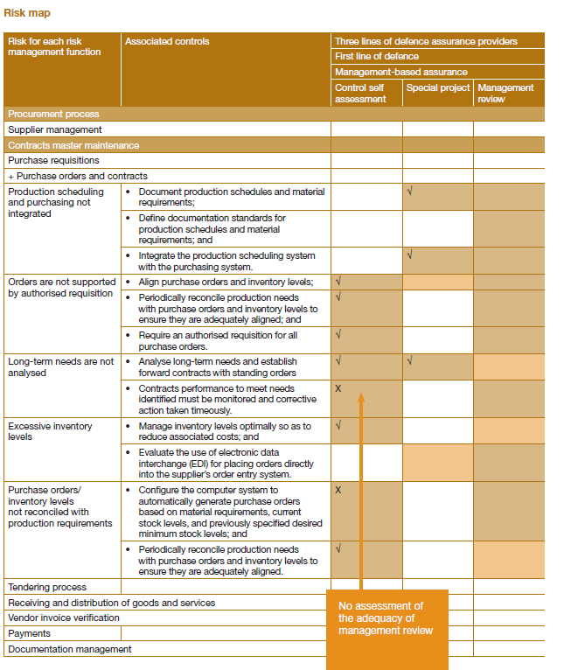
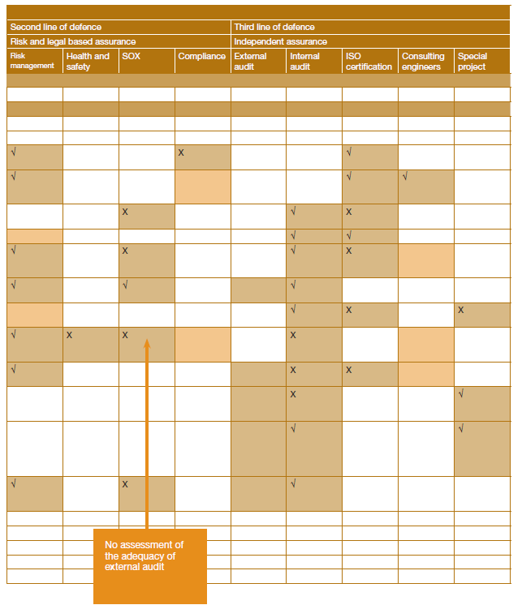

Slide 34
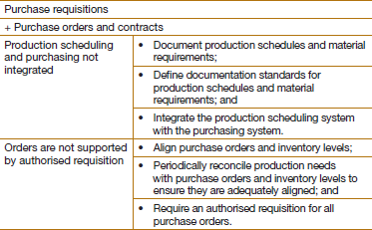
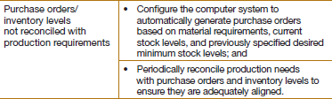

Slide 35



Slide 36
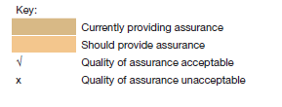

Slide 37
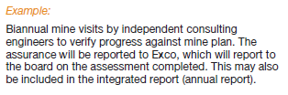
Step 4:- Combined assurance design
What assurance to be provided by whom

Slide 38

Step 4:- Combined assurance design
Agree common universe
  Risk profile relevant to business operations as oppose to within the different business units or assurance providers

Slide 39

Step 4:- Combined assurance design
Acceptable methodology/credibility
  Skills and experience of assurance providers

Slide 40
Step 4:- Combined assurance design
Ownership of the blueprint
  King 3 recommends the Audit Committee
  Internal audit to continuously review and update

Slide 41
Step 5:- Making combines assurance a continuing reality
Champion to the approach
Internal audit usually best placed
Diligence and effort should be balanced with the value derived out of combined assurance
King 3 – IA to provide assurance on controls
  Only way is combined assurance – diversity of risks

Slide 42
Step 5:- Making combines assurance a continuing reality
Provide assurance based on adequacy of own work, backed by IIA’s QA program
Need to assess adequacy of work done by other assurance providers
  Coverage
  Methodology
  Reporting
Reliance on third parties – similar to external audit reliance

Slide 43
Step 5:- Making combines assurance a continuing reality
What do want to get out of it?
Develop a combined assurance plan – treat it as a project
Follow a process and risk approach, or risk approach only
Don’t over complicate – start with the strategic risks and build from there.
Involve all stakeholders, AC, ERM, IA and EA
Link risk management activities with assurance activities

Slide 44
Benefits of Combined assurance
Reduce assurance fatigue through better coordination
Provide priorities for remediation
Improve the value of assurance
Enhance corporate governance practices

Slide 45
Criteria for assessing assurance providers
Independence/objectivity
Conflict of interest
Skills and experience
Qualifications
Assurance methodology
Accreditation body

